Slide 1
Key Stage 2 Maths Workshop

Slide 2
What to expect in this workshop
1.
How is Maths taught at Bishop Chavasse?
2.
What does Maths look like in Key Stage 2?
3.
How can my child be supported at home?
4.
Questions

Slide 3
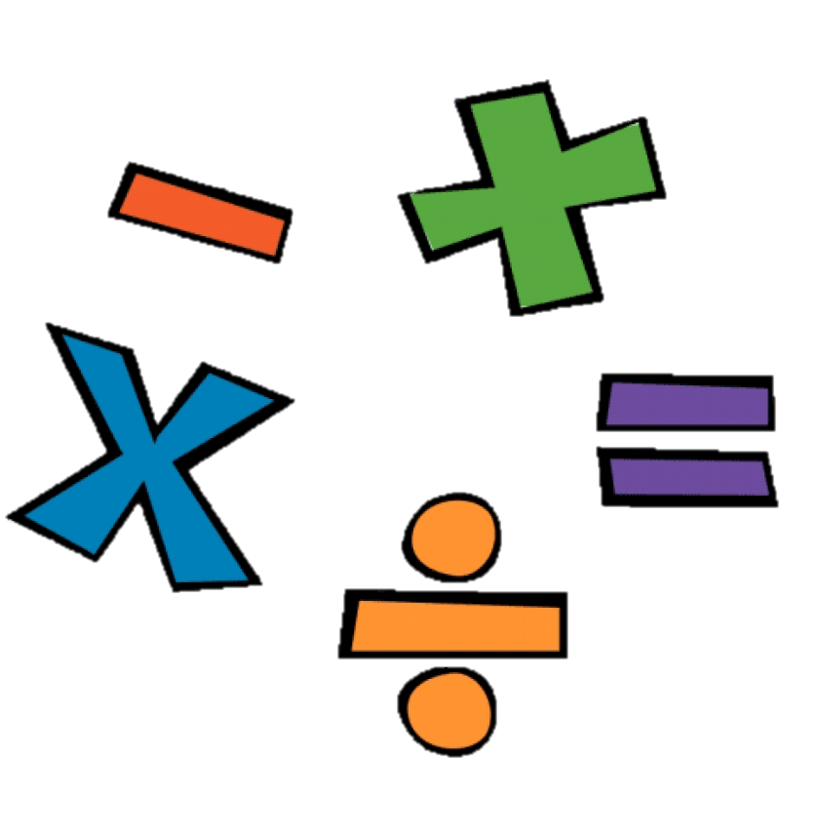
How is Maths at Bishop Chavasse?
Use of the CPA approach
Mastery approach adopted
White Rose Scheme followed - https://whiteroseeducation.com
Develop fluency, reasoning and problem-solving skills

Slide 4
What is the CPA approach?
Notes:
Approach is used to teach all four operations across the school.
These are add & subtract, multiply and divide – these underpin all we do in Maths.

Slide 5
Concrete Stage
Concrete resources, also known as manipulatives, are physical objects that children can pick up and manipulate to improve their maths knowledge.
Handling and manipulating objects can enhance your child's understanding or different mathematical concepts.
Notes:
Concrete materials allow your child to visualise and understand the maths meaning they are more likely to understand and accurately remember methods.
One of the main reasons these resources play a key role in learning is because they support the mastery style approach, meaning your child will develop a deep knowledge and understanding of vital maths concepts.

Slide 6
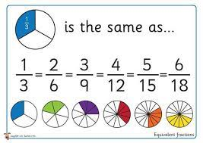
Pictorial Stage
As the name suggests, this means that your child is looking at a picture (or visual representation) to help them solve a calculation.
This could be a drawing of objects to be counted, but could also be a part-whole model, bar model or base 10 drawing.
Notes:
Having a picture of the problem often helps children to understand what is required of them to solve a calculation.

Slide 7
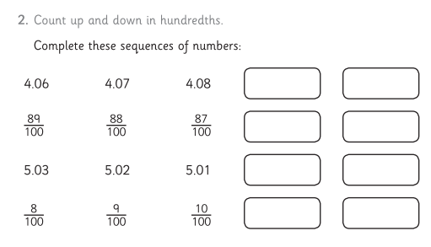
Abstract Stage
The abstract stage is when children face questions using numbers and symbols or key vocabulary alone.
If children enter this stage before establishing secure links or points of reference as to what the numbers, operations or key words mean, they will find this stage challenging.
At this stage, your children are expected to have a depth of knowledge that can now be applied without the need for concrete or pictorial support strategies.
Notes:
It is really important that children can move freely within these stages.
Important not to rush.
Children’s ability to move through each stage helps them to deepen their knowledge and understanding.

Slide 8
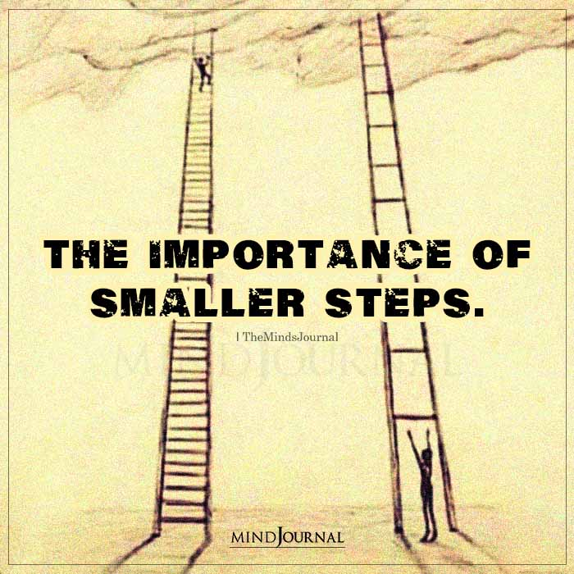
Not racing up the ladder!
When children learn a new concept, it is important not to race up the ladder.
Spending time embedding what they know and taking small steps is vital.

Slide 10
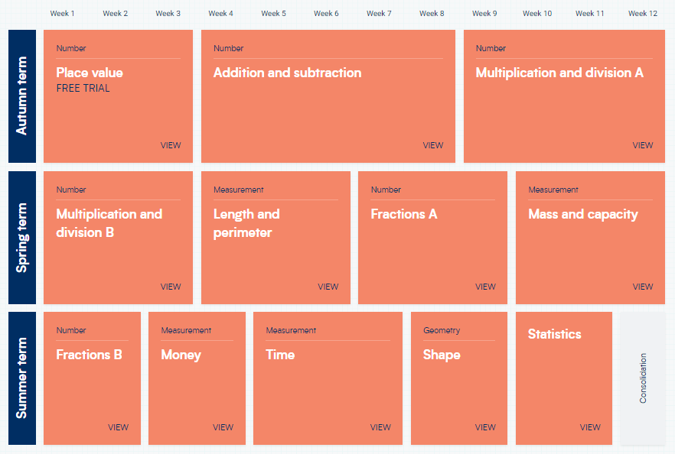
What is is my child learning?
Notes:
Year 1 emphasis on place value and understanding number – securing foundations
Year 2 more in depth 4 operations

Slide 11
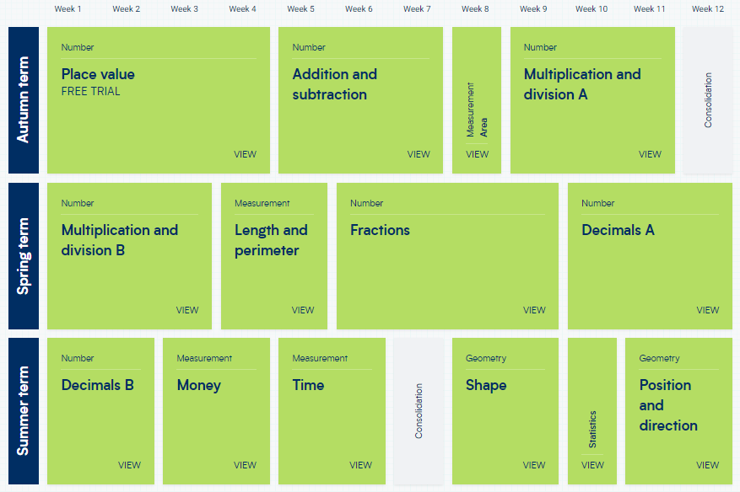
What is is my child learning?
Notes:
Year 1 emphasis on place value and understanding number – securing foundations
Year 2 more in depth 4 operations

Slide 12
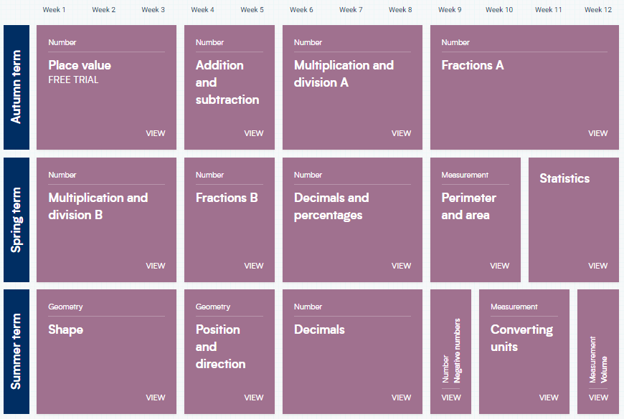
What is is my child learning?
Notes:
Year 1 emphasis on place value and understanding number – securing foundations
Year 2 more in depth 4 operations

Slide 13
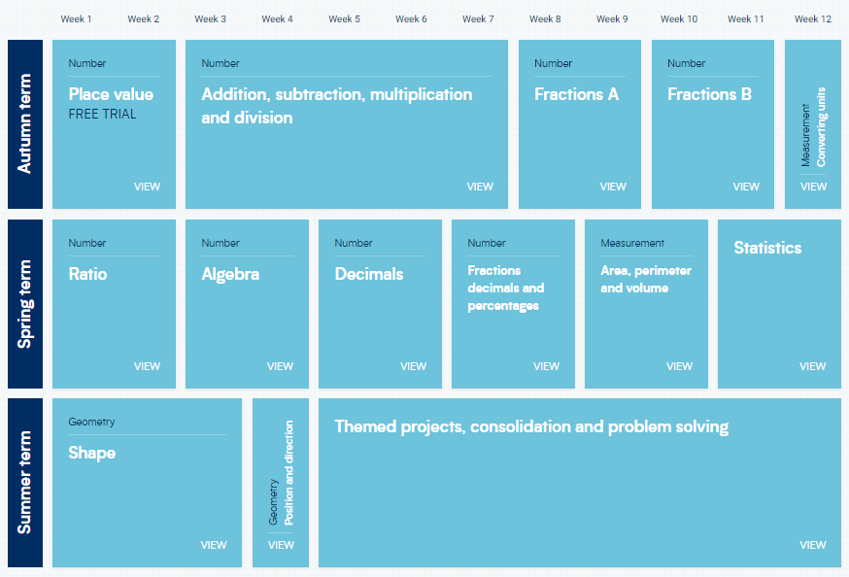
What is is my child learning?
Notes:
Year 1 emphasis on place value and understanding number – securing foundations
Year 2 more in depth 4 operations

Slide 14
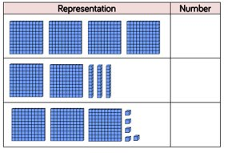
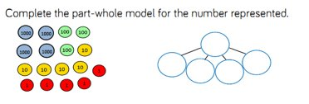
Place value

Slide 15
Understanding Equivalence

Slide 16
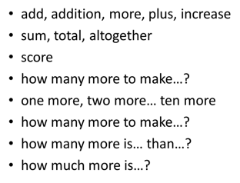
Addition

Slide 17
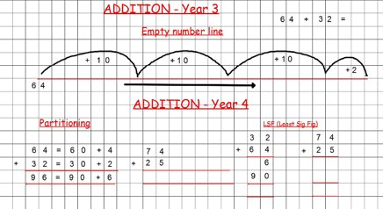
Stages of teaching addition

Slide 18
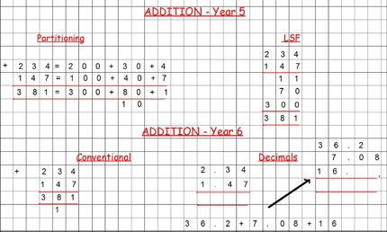
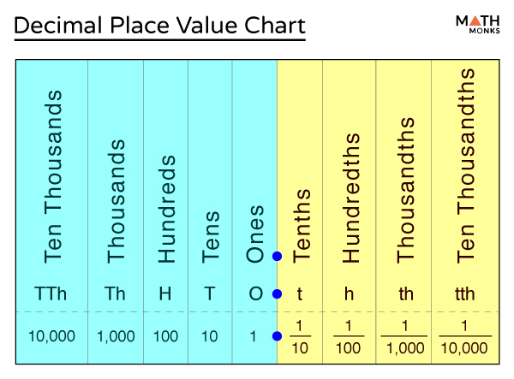
Stages of teaching addition

Slide 19
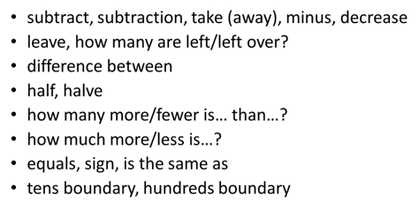
Subtraction

Slide 20
Stages for teaching subtraction

Slide 21
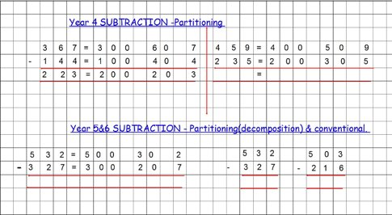
Stages for teaching subtraction

Slide 22
Multiplication

Slide 23
Repeated addition
5+5+5 = 15

Slide 24
Introducing the multiplication sign x
5+5+5 = 15 is the same as 3x5=15

Slide 25
Helping children see links

Slide 26
Helping children see links

Slide 27
Helping children see links

Slide 28
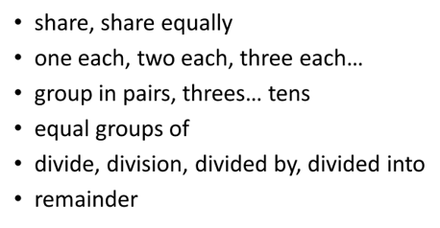
Division

Slide 29
Division is an introduction to sharing equally and fractions.

Slide 30
Division is an introduction to sharing equally and fractions.

Slide 31
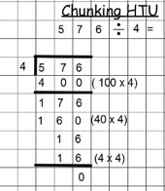
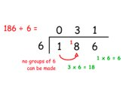
Division is an introduction to sharing equally and fractions.

Slide 32
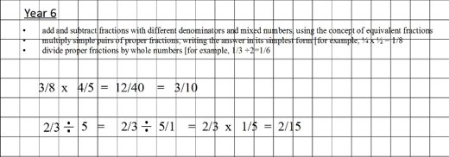
Fractions

Slide 33
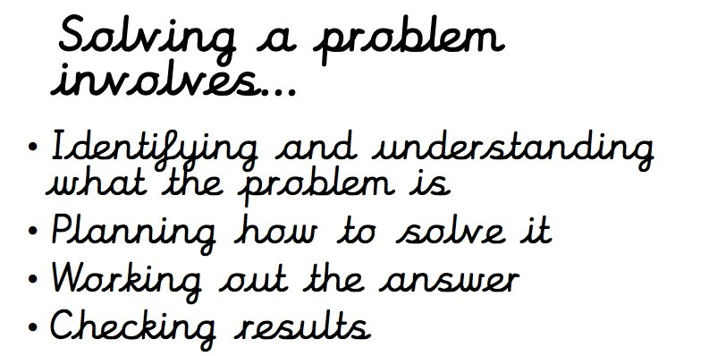
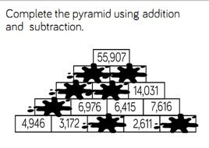
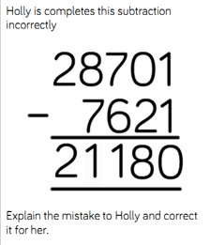
Problem Solving

Slide 34
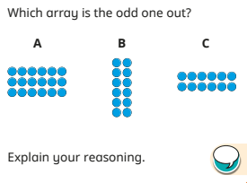
Reasoning

Slide 35
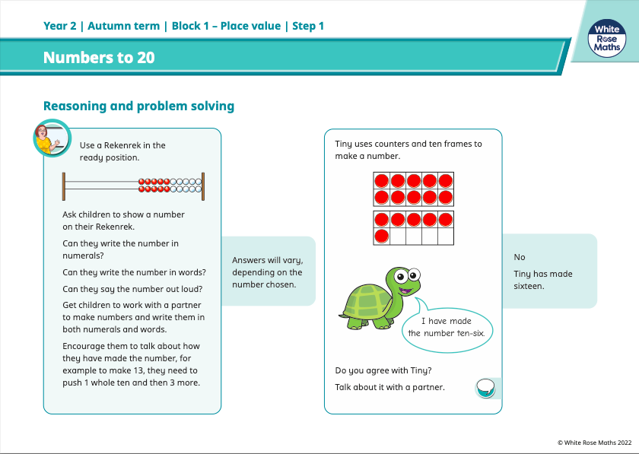
Maths – What can we access at home?
Notes:
Access to the key learning and problem solving and reasoning on the scheme of work

Slide 36
Maths – What can we access at home?
Notes:
Access to free digital tools discuss in the pictorial stage

Slide 37
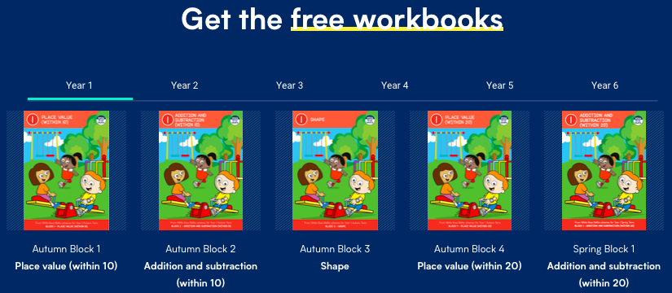
Maths – What can we access at home?
Notes:
Also videos for parents to help children at home
Also home learning videos – takes you through the WR slides
If you would like to know more, please ask at the end

Slide 38
Resources you can use at home
Notes:
Numberblocks created by mastery specialists
Children engaged if used in school

Slide 39
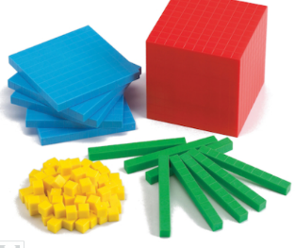
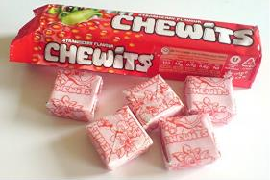
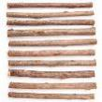
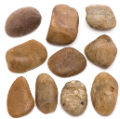
Addition and Subtraction using sweets or sticks and stones instead of base 10

Slide 40
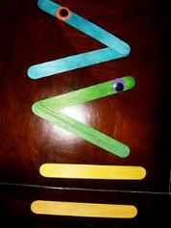
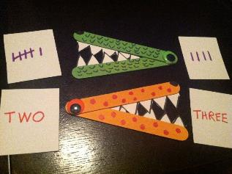
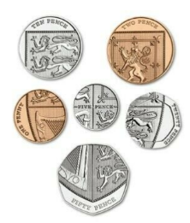
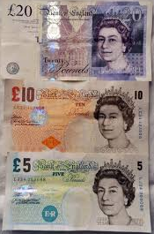
For greater, less than or equal to you could use lolly sticks.
For money work or problems you could use your own coins/ notes.

Slide 41
https://nrich.maths.org/9413

Slide 42
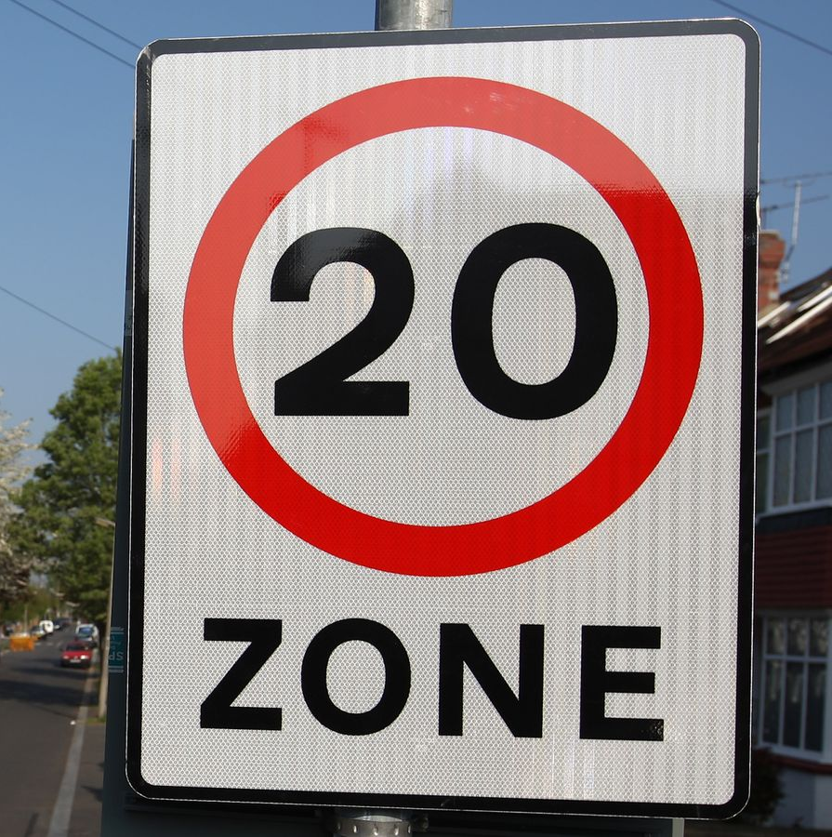
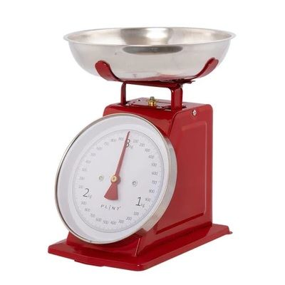
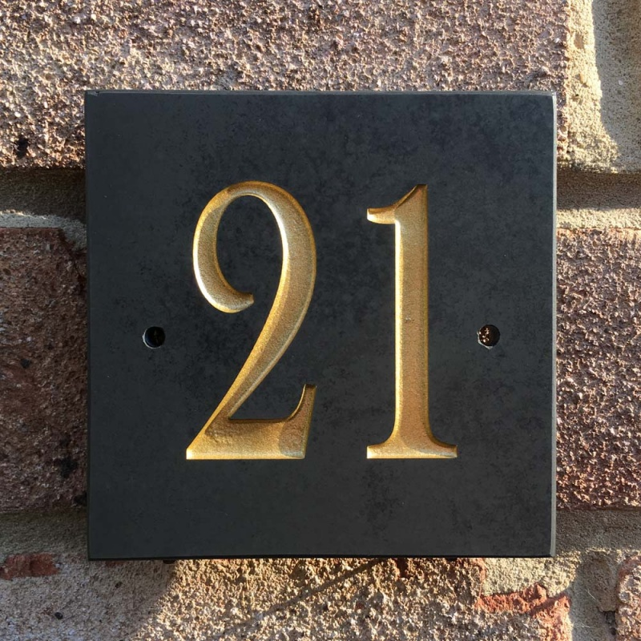
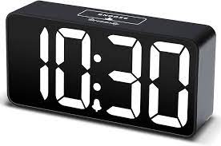
Maths is all around us!
Notes:
Even football games, scores etc.

Slide 43
Notes:
Not enough time given to teach telling the time - appreciate if you could help at home so we can simply embed and consolidate

Slide 44
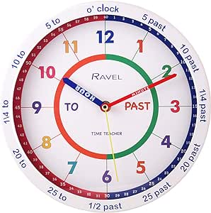
Notes:
Not enough time given to teach telling the time - appreciate if you could help at home so we can simply embed and consolidate

Slide 45
Any questions?

